Slide 1
Notes to BBNC speaker:
Remember to go through this presentation before you deliver it and tailor a few details for your situation:
Add you name to slide 4.
If you are presenting in person, delete (or prepare to skip) slides 5 & 6 about the zoom call.
Cue up the video in a separate tab: https://www.youtube.com/watch?v=oHRPMJmzBBw
-- Make sure you have adjusted sound settings to show the video -- see next slide!
Cue up the Demo in a separate tab: www.fairvote.org/Demo1
DELETE SLIDES 1 & 2!! (Or cue up the presentation starting on slide 3).

Slide 2
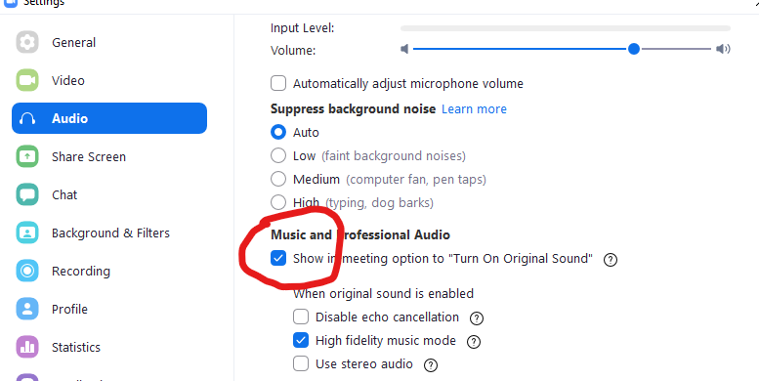
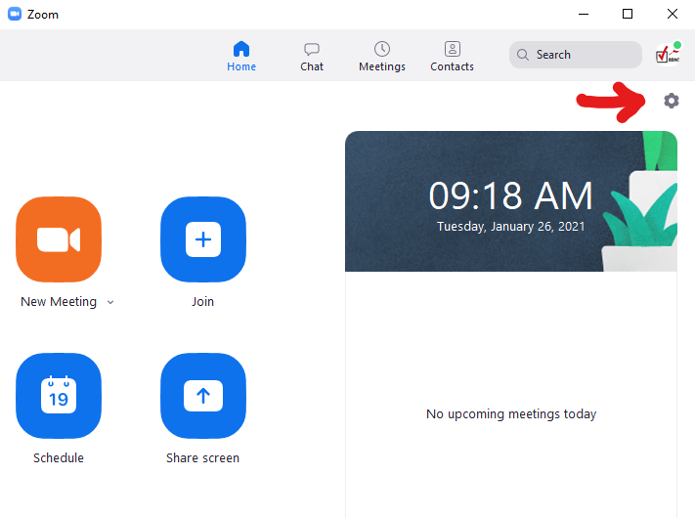
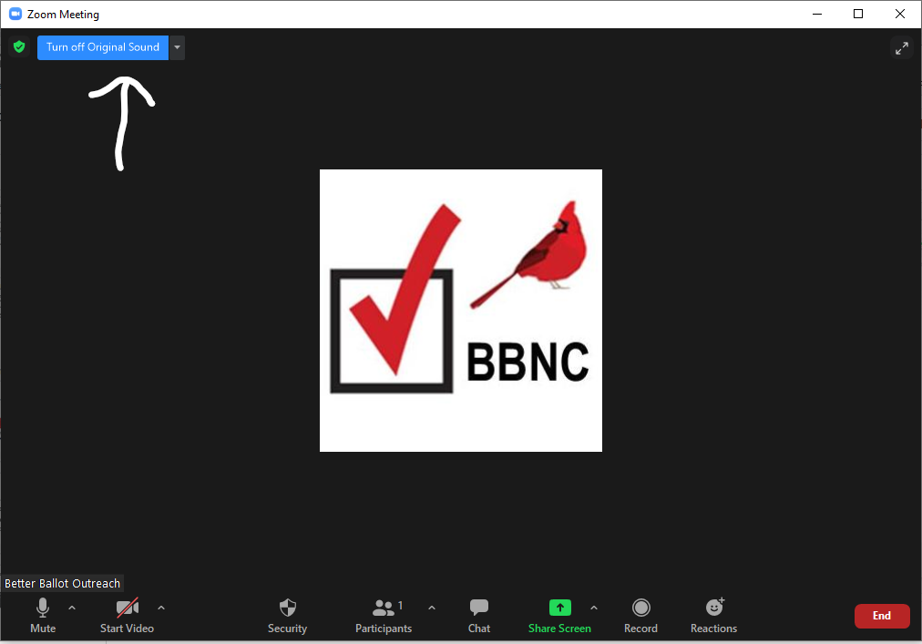
Turn on sound for the video:
1) Open your zoom window (before starting the meeting)
Click on the SETTINGS icon -- upper right
2) Click AUDIO on the list
Make sure show in-meeting option to “turn on original sound” is checked.
3) Start the zoom meeting
Click Turn on original sound - upper left
Now when you play the video, the sound will be heard through Zoom.

Slide 3


Slide 4
Ranked Choice Voting: A Better Way to Vote
Presenter: Vicki Ryder
Co-Lead, Outreach Team
Better Ballot NC
November 8, 2021
Notes:
It’s good to present as a team, preferably with gender and racial diversity, if possible.

Slide 5
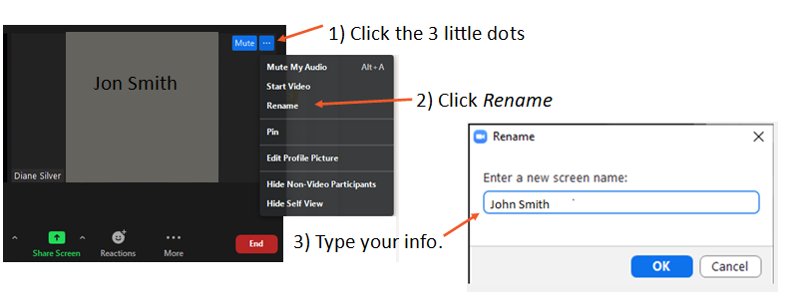
Update your name on Zoom:
Jon Smith

Slide 6
Please sign in, so we have your contact info:
Just type your name and e-mail in the chat bar.

Slide 7

Nonpartisan advocate for ranked choice voting, to give voters greater choice, a greater voice, and a more representative democracy for all.
Who/What is Better Ballot NC?
Notes:
Introduce our organization.

Slide 8
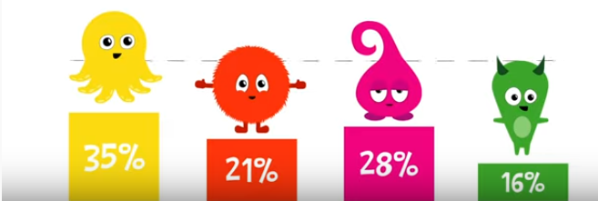
Current Electoral Method: Plurality Most votes wins – period!
W I N N E R !
Also called “winner take all”
Notes:
Click to add speaker notes.

Slide 9

Why do we need a better method?
Because Winner Take All has a lot of problems!

Slide 10
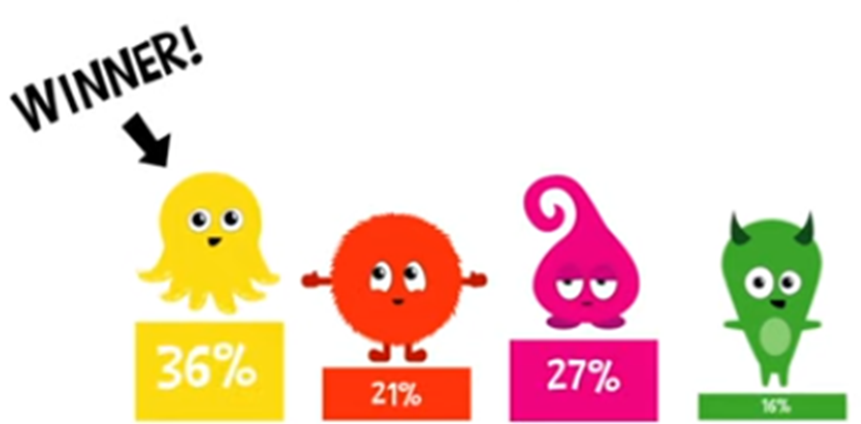
Problem 1 : Non-Majority Winners
64% wanted someone else!
Notes:
Most people think majority rule is a basic tenet of democracy, but we actually don’t have it!

Slide 11
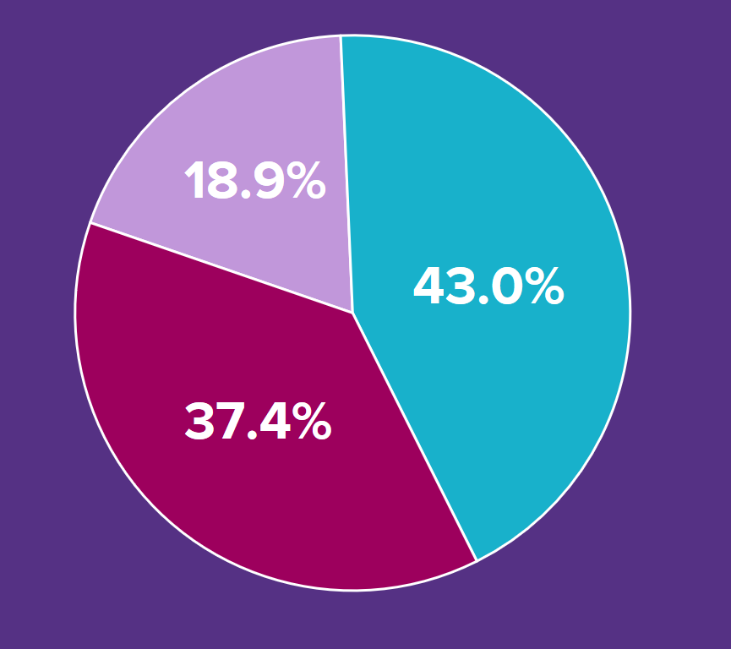
ELECTION OF 1992
PEROT
CLINTON
(WINNER)
margin of victory: 5.6%
BUSH
Notes:
Real-world example

Slide 12
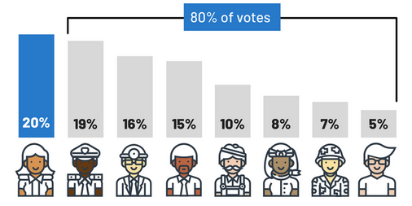
Winner-Take-All gets worse with more candidates. Winners can take office or win the nomination with only 30% support!
70%
30%
24%
16%
12%
8%
5%
3%
1%
Notes:
A highly fractured field means “winners” or “front-runners” have only a small % of support – it’s just that it’s a tiny bit higher than everyone else.
Biden was considered a “front runner” before the first vote was even cast in Iowa, because he was at 25-30% in early poll results.
But at that point in the race, SEVENTY PERCENT (70%) wanted someone else, it was just divided among 28 other candidates.
18 candidates, with only single-digit polls numbers (1% or 2%) dropped out before the voting even started. They had no hope of catching up to Biden’s lead.

Slide 13
Problem 2:
In a partisan environment, when two (or more) candidates have similar views, they split the votes on their end of the political spectrum. This actually HELPS the candidate they like LEAST:
Vote Splitting
Notes:
Need a good cartoon graphic for vote-splitting (not a chart). Something humorous.

Slide 14
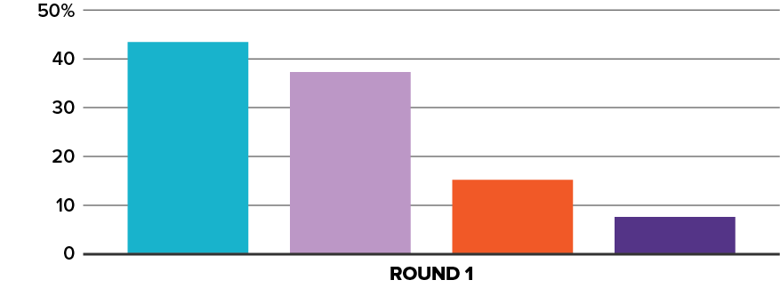
Pizza Vote 54% want meat!
Meat-eaters vs. vegetarians
46 %
38 %
With plurality voting,
vegetarian pizza would win.
16 %
“spoiler”
Sausage Pepperoni Veggie
Supreme
Notes:
In this example, the meat “party” is split between two options, while the veg “party” is united around one candidate.
RCV doesn’t benefit one party over the other. It works the same for both sides of the partisan spectrum, depending which one may have multiple options.
It represents the true will of the VOTERS.

Slide 15
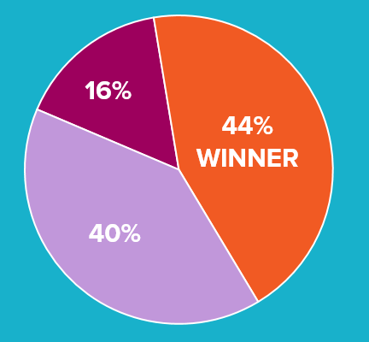
Vote-splitting leads to
Strategic voting – voting for your 2nd or 3rd choice because you know your real favorite is unlikely to win.
Limited voter choice 3rd party and independent candidates are discouraged from running at all.
Notes:
Limited voter choice:
Too often, to avoid “vote splitting” in which candidates can and do win with very little support, efforts are taken to limit the number of candidates who compete. This limits voters’ choices.
Strategic voting
Voters should be able to vote for candidates they support, not just against candidates they oppose most. Yet in elections without ranked choice voting, voters may feel that they need to vote for their 2nd choice because their favorite candidate is less likely to win.
Non-majority winners
Too often, candidates can and do win elections despite being opposed by most voters. Take a look at this pie chart: the winning candidate won with only 44% of the vote, but 56% of voters didn’t select that candidate!
Wasted votes
With RCV, if a voter’s first choice drops out the race, their vote simply goes to their second choice rather than being “wasted”.

Slide 16

Manipulating the System
Both major parties have weaponized vote splitting to try to gain advantage.
aka
Weaponizing
Plurality Vote-Splitting
2020 FL State Senate race, District 37:
Independent candidate Alex Rodriguez emerged relatively late
Kansas 2020 U.S. Senate Primary:
Dems spent millions through a liberal Super PAC backing the hard-right conservative, who would be easier to beat in the General.
in the game and just happened to have the same surname as the Democratic candidate (José Javier Rodríguez), thus confusing the voters and successfully splitting the vote, so the Republican won by plurality (by a mere 34 votes)!
Negative ads misleadingly attacked the moderate as a “Never Trump,” “Romney Republican.”
Notes:
Some campaign strategists manipulate the spoiler effect to create vote-splitting for the “other” side.
1 Dem examples and 1 GOP example. Here’s an article about the FL Senate race:
https://www.orlandosentinel.com/politics/os-ne-npa-candidate-investigation-20201216-4ut3dzzzq5cebjuzt6aeqlvxde-story.html
(This may be overkill. Delete this slide if it’s too much for your audience. Or maybe move to the end for deeper discussion).

Slide 17
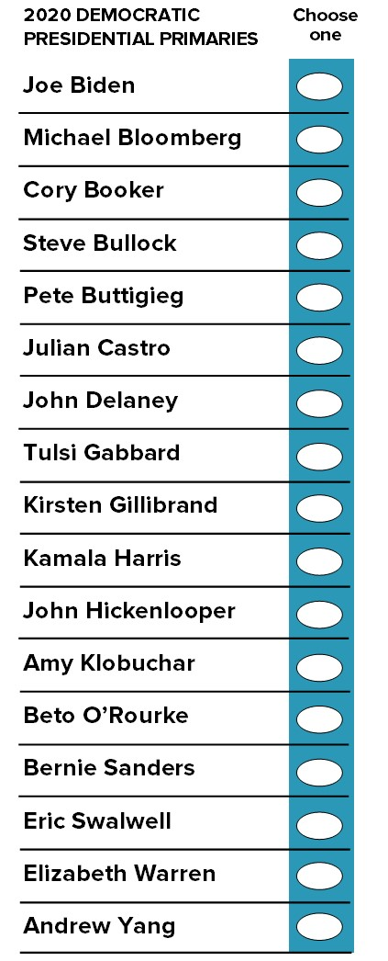
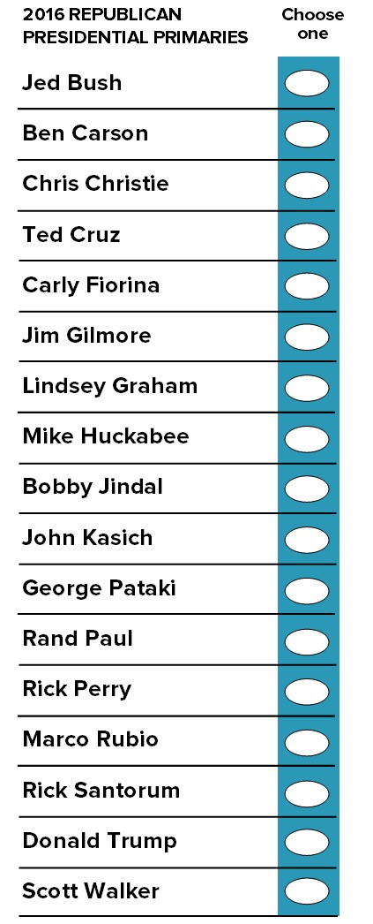

Problem 3: Wasted Votes
PRIMARIES:
2020
Over 2 million wasted votes on Super Tuesday
people who voted early, for a candidate who dropped out before election day.
More than 4.5 million total wasted votes.
2016
Over half-million wasted votes
Many cast by military personnel and overseas voters.
+ 12 more!
Notes:
Early voting is an important voter turnout tool, but it can result in wasted votes when candidates drop out as the primary season progresses.
2020: Millions of voters wished they could have a “do-over,” but of course it’s illegal to vote twice and there was no way to nullify their original vote.
29 original candidates.
18 withdrew before voting began.
Feb 3 & 11 – Iowa & NH vote
Feb. 11-12 – Yang, Patrick, Bennet withdraw.
Feb. 22 – Nev votes
Feb 29 – SC votes. Steyer withdraws
Mar 1 & 2 – Buttigieg & Klobuchar withdraw
Mar 3 – Super Tuesday. Only 5 remained.
Same story for GOP in 2016.
In Arkansas, Missouri, and Vermont, the number of wasted votes exceeded the margin of victory.
Very likely to be the same story for BOTH PARTIES in 2024.
FYI: FV’s wasted vote tracker (just for data wonks!)
https://www.fairvote.org/wasted_vote_tracker
2016 data
2020 data

Slide 18
General Elections
Vote-splitting leads to WASTED VOTES
People feel that they will waste their vote if they vote for their true favorite knowing they are a long-shot.
Notes:
We shouldn’t have to choose between voting our conscience and voting strategically to get the best VIABLE candidate.
Note: some people get offended if you say they wasted their vote by voting for their true favorite. Assess your audience. Maybe say “symbolic vote” rather than “wasted” vote.

Slide 19

Problem 4:
With only two candidates,
Hyper-partisanship
Negative Campaigning
!
!
#
$
Notes:
Just look at the current state of elections!

Slide 20
Problem 5:
Run-offs are EXPENSIVE – for taxpayers and for candidates.
Notes:
Run off in GA cost half a BILLION dollars – candidate spending + taxpayer cost to re-run the election.
In NC: data coming soon from the research team.

Slide 21
PROBLEMS WITH OUR CURRENT METHOD
ReCap:
Winner-Take-All, Plurality win:
Non-majority winners
Vote-splitting
Strategic voting
Limited voter choice
Wasted Votes
Hyper-Partisanship
Negative Campaigning
Gaming the system

Slide 22
There IS a better way…

Slide 23
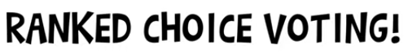
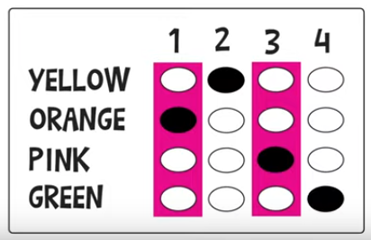
Notes:
With ranked choice voting, voters get to rank candidates in order of preference.

Slide 24
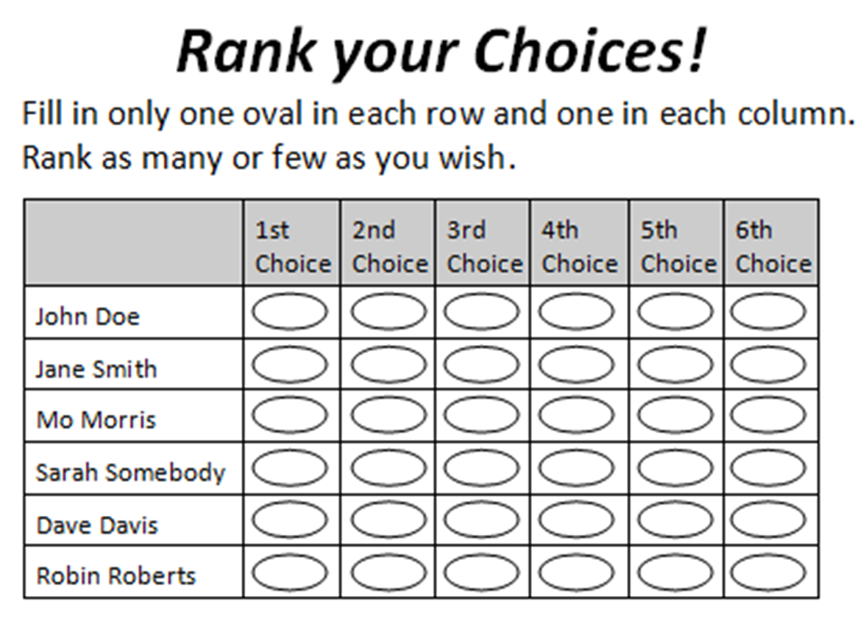
How it works
1) Voters rank the candidates
EASY AS
1-2-3
Notes:
Emphasize these points:
You don’t HAVE to rank. For those who think this is a bad idea, they can just vote for one, like they always have!
You can rank SOME, but not all. If you only like 3, you can rank 1-2-3 and leave the rest blank. It’s the same as saying, I hate all the remaining candidates equally so I’m not even going to vote in the run-off anymore. That’s fine.
1 per row, 1 per column ensures you didn’t make an error, which could invalidate the ballot.

Slide 25
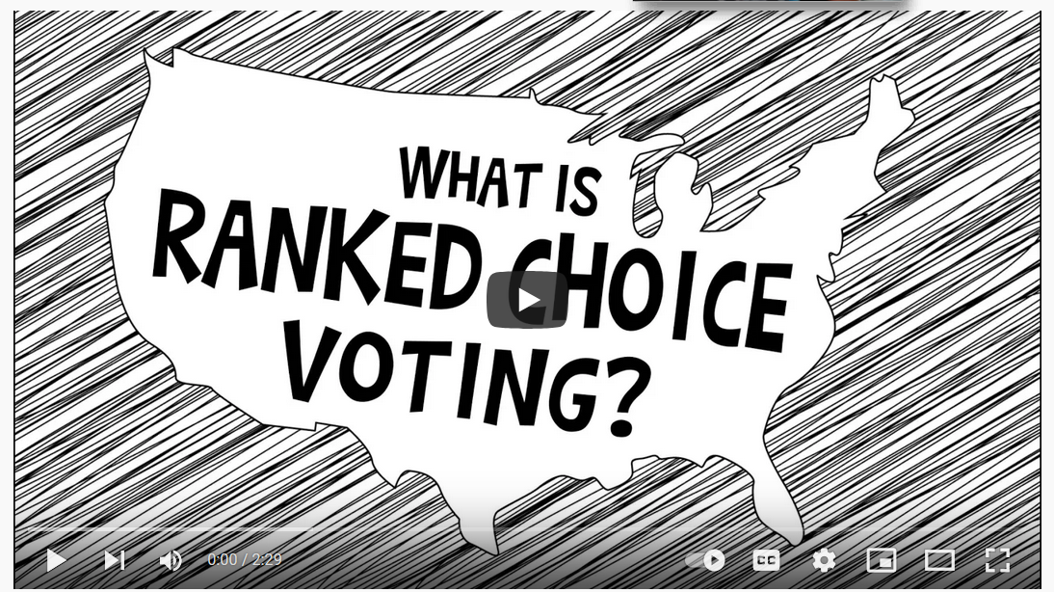
https://www.youtube.com/watch?v=8Z2fRPRkWvY
Notes:
Show the video, then emphasize these points:
RCV is also called Instant Run-off Voting because that’s what it is!! Think of each round as a run-off, but instead of the hassle and cost (and vastly reduced participation) of actually going back to the polls, voters make their run-off choices known from the beginning.
This is ONE-PERSON, ONE-VOTE. In each round of voting, every voter gets one vote, just like we do now. We already have run-off elections, where you vote once in the first round, and then you vote again in the 2nd round. This is the same thing. It’s not like some people get several votes and others only get one. If there’s a run-off round, EVERYONE gets to vote again -- they just don’t have to wait three weeks and then go back to the polls to do it.
The important difference is that right now, we only have a run-off if the winner wins by less than 30%. That’s crazy. With RCV, you have to pass the 50% threshold to win! That’s majority rule. Can we all agree that that’s a basic principle of democracy?!

Slide 26
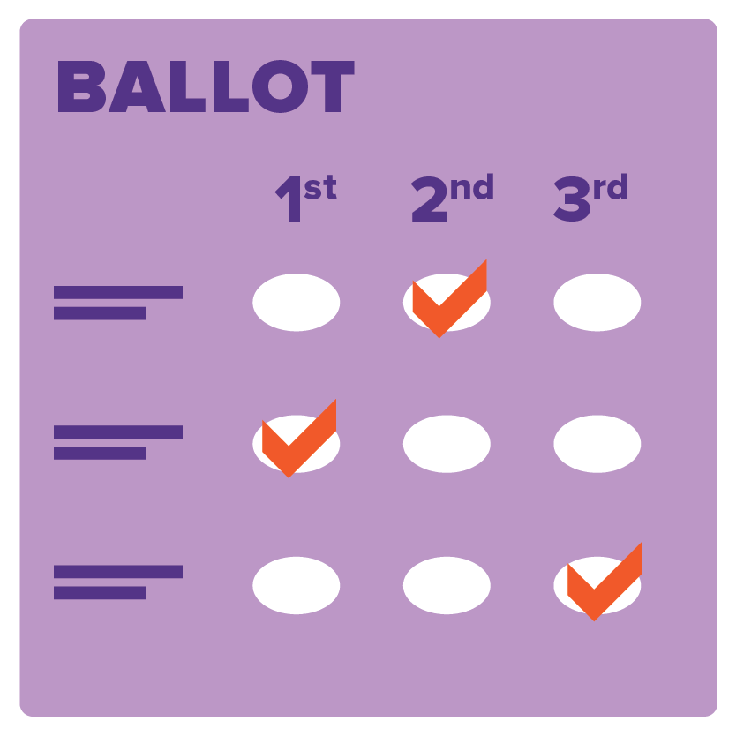

Rank your favorite ice cream flavor
Let’s give it a try
Ranked
Choice
Voting
Take a few minutes to vote using this link.
www.FairVote.org/Demo1
Notes:
Do the demo. Have folks whip out their phones, or open a new tab on their computer and do it right now.
(Presenter – do this yourself before your presentation, to get familiar with it).

Slide 27
BENEFITS OF
RANKED CHOICE VOTING
More Choice
Eliminates Spoiler Effect
Changes Political Incentives
More-Positive Campaigns
Majority Winners
Notes:
More Choices
Ranked choice voting allows more than two candidates to compete without fear of splitting the vote. You can vote for your favorite candidate without worrying that you’ll inadvertently help elect the candidate you like the least.
Spoiler-free
A majority of Americans don’t feel represented by either of the major political parties. Ranked choice voting allows them to vote for the candidates who best represent their views - including independent and third-party candidates - without fear of wasting their vote or inadvertently helping elect the person they like least. And candidates of all viewpoints can legitimately compete without being criticized or pressured to drop out.
In Maine’s 2nd Congressional District, 8 percent of voters cast first choices for one of the two independents because they knew they could rank a second and third choice. And unlike many other key races across the country, neither of the independent candidates were pressured to drop out or criticized for acting as spoilers.
Civil Campaigns
Ranked choice voting creates more issue-focused and civil campaigns. It gives candidates incentives to work together, or at least not criticize one another, in the hopes of earning a voter’s second or third choice, if not their first.
Majority Winners
Ranked choice voting ensures candidates win elections with the broadest possible support. Avoiding scenarios in which a candidate wins with less than 50 percent of the votes legitimizes outcomes for voters and candidates.
More than 62 percent of Maine 2nd District voters surveyed in an exit poll said majority winners were important.
(Note: we look to Maine for proof because they’ve used it statewide in a few elections now. Also several cities: Minneapolis, San Francisco, Oakland, Santa Fe).

Slide 28
Who BENEFITS from
RANKED CHOICE VOTING
Voters
Candidates
Parties
Community
Democracy
Notes:
Keep going for details on each one -- this is an introductory slide for the next 5.

Slide 29
For VOTERS
More candidates to choose from / More views represented
Can vote their conscience without fear of wasting their vote
Voice is heard all the way to the end
No need to return to polls for runoffs

Slide 30
For CANDIDATES – Incumbents or Challengers
More positive campaigning / less mudslinging
Avoid being cast as spoilers
Avoid the cost of runoff campaigns
Winner can claim majority support / stronger mandate
Less fear of being “primaried” -- can run collaboratively with other candidates in your party

Slide 31
For PARTIES: GOP, DEMs, & Others
Bigger umbrella:
Room for a broad range of ideas – reduce factions within the party
Could have more than one nominee
In primaries: nominee will be the one with broadest support within the party – motivates turnout for the general election

Slide 32
For COMMUNITY
Avoid the cost of run-off elections -- $ MILLIONS saved
Reduces rancor and conflict –
more positive campaigning
clear winner (majority)
no blame for voters who voted their conscience

Slide 33
For DEMOCRACY
Everyone’s voice is heard
Every vote counts
Increase in voter participation
Better informed voters
More engaged citizens

Slide 34
Questions?
Notes:
Notes for presenter:
Refer to FAQ document for answers to common questions.
Do not get sucked in to a debate about RCV vs other alternative methods such as STAR, Score, or Approval voting. Refer those questions to the team lead. (Take the asker’s name and contact info and assure them that someone will get back to them). We don’t want to have that debate in front of the whole group because it just gives air time to the opposition. You can claim any reason that feels comfortable:
no time for that deep discussion now, but we’d love to talk with you in more detail 1:1;
I’m new at this myself and I’m not sure of those comparisons; let me put you in touch with our Outreach Leader.
If you don’t know the answer to something, say so honestly; dont fudge an answer.. Ha, you got me on that one! Let me get your contact info and get back to you.

Slide 35
Our request today
Individual support:
Sign on as a supporter
Sign up to volunteer
Support the work (financial donation)
Notes:
As a supporter, you’ll have the opportunity to opt in or out re receiving updates. If you agree RCV is a good idea but you really don’t want to “join” anything, you can opt out of being involved and it’s really just like signing a petition.

Slide 36
How to sign up right now
on our website (on your phone)
or sign the paper sign-up sheet
Notes:
Website is easier for us -- no extra data entry; but paper sign-up is fine if they prefer or don’t have online access right now. Bottom line -- we want them to sign up RIGHT NOW if they’re willing.

Slide 37
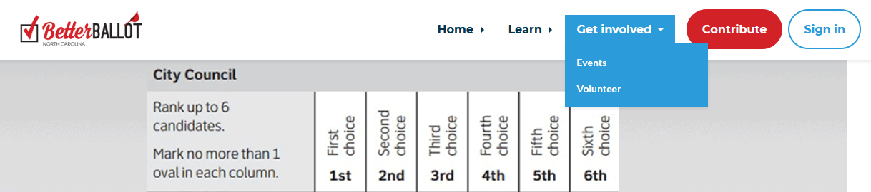
www.betterballotnc.org
Internal note: John needs to add two more options:
Add your name as a supporter
Join BBNC as a member
Click on “Get Involved”
Notes:
This image will be updated -- it should include an option for becoming a supporter or a volunteer.

Slide 38
One more request
Group support -- endorse RCV
Sign a statement of endorsement
Post info about RCV on your website and in your materials
(We’ll be following up with you on this.)
Notes:
gives permission for us to publicize their name as an endorser on our website and materials

Slide 39
Thanks for having us today.

Slide 40
Extra slides, only if time / if needed

Slide 41
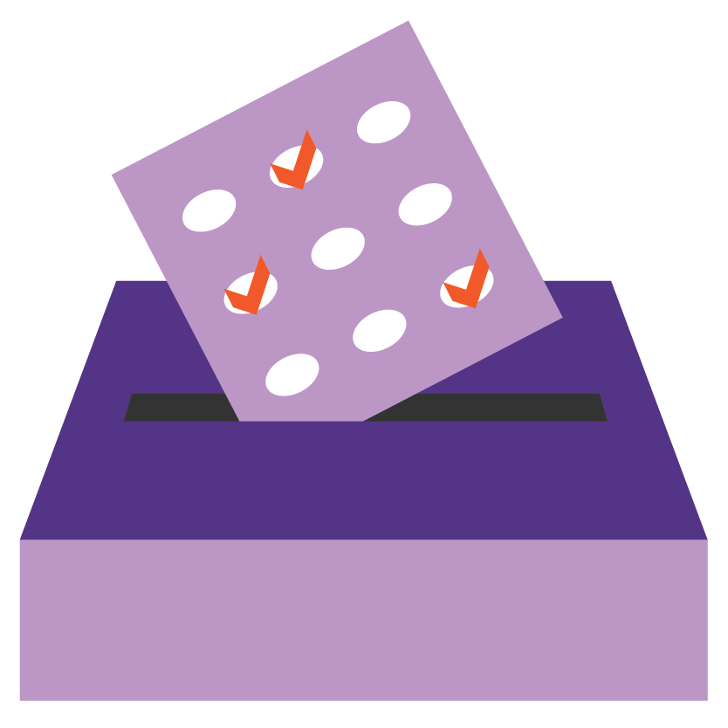
Where, and How is ranked choice voting used?
Currently used to elect
Mayors
City Councils
Members of Congress & President! (Maine)
Presidential Primaries
(5 states in Dem primary in 2020)

Slide 42
Where is RCV used
First state to use RCV for their Presidential election, this Nov. Congressional & Senate too!
Cities in:
California
Massachusetts
Colorado
Minnesota
Maine
New Mexico
Maryland
Virginia
Michigan
Utah
Presidential primary use in 2020:
Nevada
Alaska
Wyoming
Kansas
Hawaii

Slide 43
RCV
Coming soon to:
New York City
Sarasota
Memphis
Albany, CA
Eureka, CA
Boulder, CO
Overseas voters:
Louisiana
Arkansas
Alabama
Mississippi
South Carolina

Slide 44
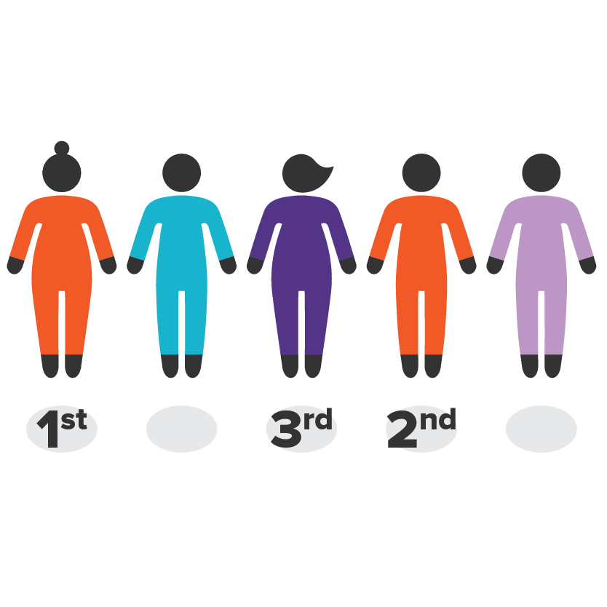
Dem Presidential Primaries 2020
Nevada
Early Voters in the caucus
Approx. 70% of total Dem voters who participated in Nevada caucuses early voted with RCV
Wyoming
Mail in ballot plus RCV
Kansas
Mail in ballot plus RCV
Alaska
Mail in ballot plus RCV
Hawaii
Mail in ballot plus RCV

Slide 45





RCV Internationally – Tried and True
IRELAND & NORTH IRELAND
NEW ZEALAND
MALTA
AUSTRALIA
SCOTLAND
Notes:
Ranked choice voting is used by every voter in Australia, Ireland, New Zealand, Malta, Northern Ireland, and Scotland, often with the multi-winner, proportional form of it (“single transferable vote”).

Slide 46
How it works (single-winner)
Notes:
If a candidate receives more than half of the first choices, they win, just like any other election.

Slide 47
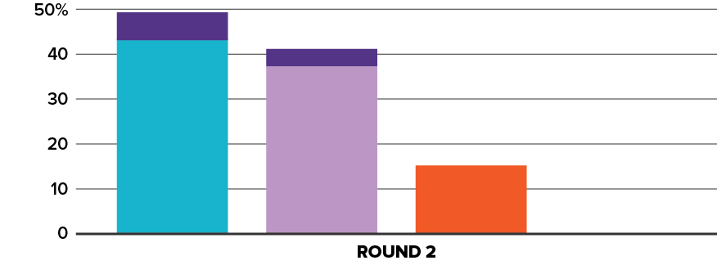
How it works (single-winner)
Notes:
If not, the candidate with the fewest votes is eliminated, and voters who picked that candidate as ‘number 1’ will have their votes count for their next choice.

Slide 48
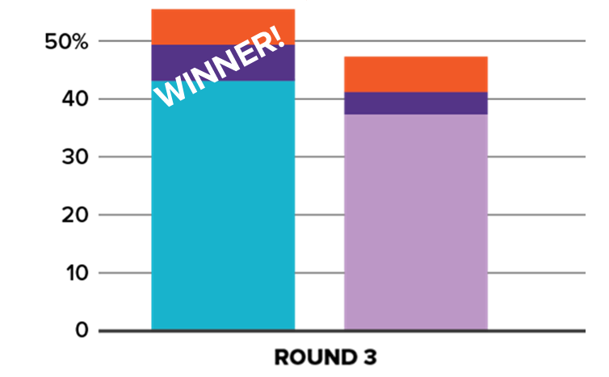
How it works (single-winner)
Notes:
This process continues until a candidate wins with more than half of the votes.

